Slide 1


MAGNETICALLY COUPLED
Firilia Filiana, S.T., M.T

Slide 2
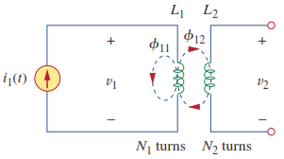

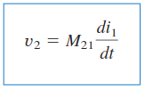
MAGNETICALLY COUPLED
When two loops with or without contact between them effect each other through the magnetic field generated by one of them.
M -> The ability of one inductor to induce a voltage across a neighboring inductor, henrys (H)

Slide 3
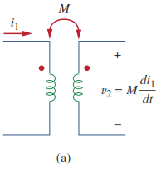
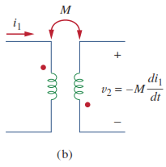
MAGNETICALLY COUPLED
Dot convention
If a current enters the dotted terminal of one coil, the reference polarity of the mutual voltage in the second coil is positive at the dotted terminal of the second coil.

Slide 4
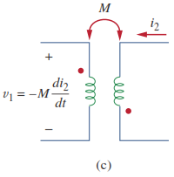
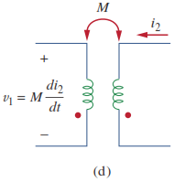
MAGNETICALLY COUPLED
Dot convention
If a current leaves the dotted terminal of one coil, the refence polarity of the mutual voltage in the second coil is negative at the dotted terminal of the second coil

Slide 5
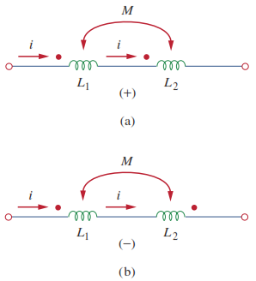




MAGNETICALLY COUPLED

Slide 6
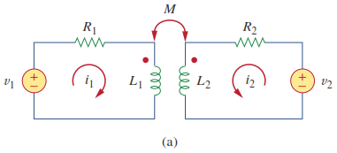
MAGNETICALLY COUPLED
Make a equation from Figure 1.
Figure 1. Electrical Circuit

